Slide 1
Data analysis
B. Priyeash
VIT University
Chennai

Slide 2
How effective the testing were done in each province?
This can be predicted by comparing the plot between number of positive cases per million population and number of positive cases per 100 tests done.
Since the population of Canada is not very high, the positive cases per million can also be scaled down to cases per hundred people.
On comparing the two, if a province has a low cases/100 people and high cases/ 100 tests, then it means that the province is doing very well in testing effectively.
If it’s the other way, that is, if a province has a high cases/ 100 people and low cases / 100 tests, then that province is very poor in testing effectively.

Slide 3
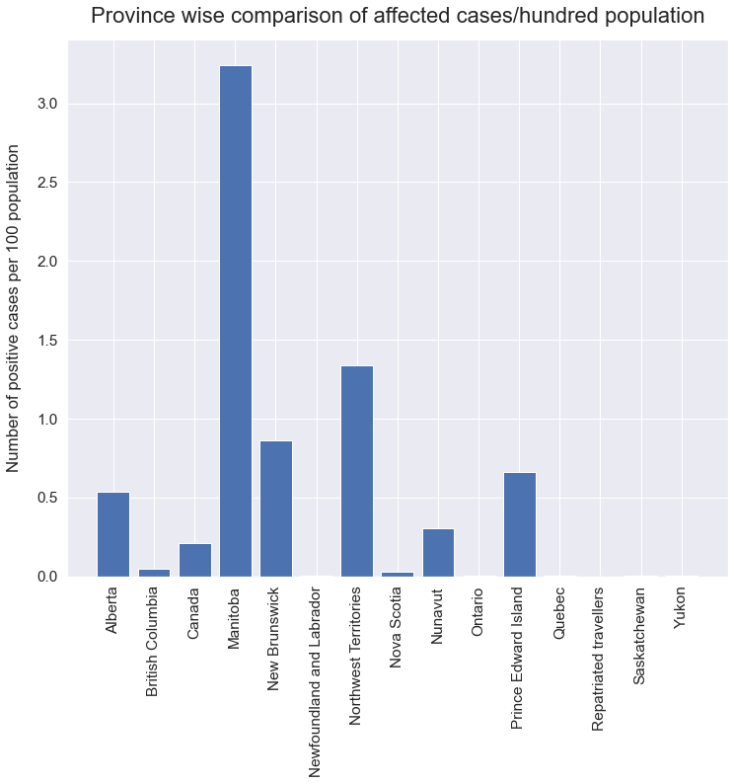
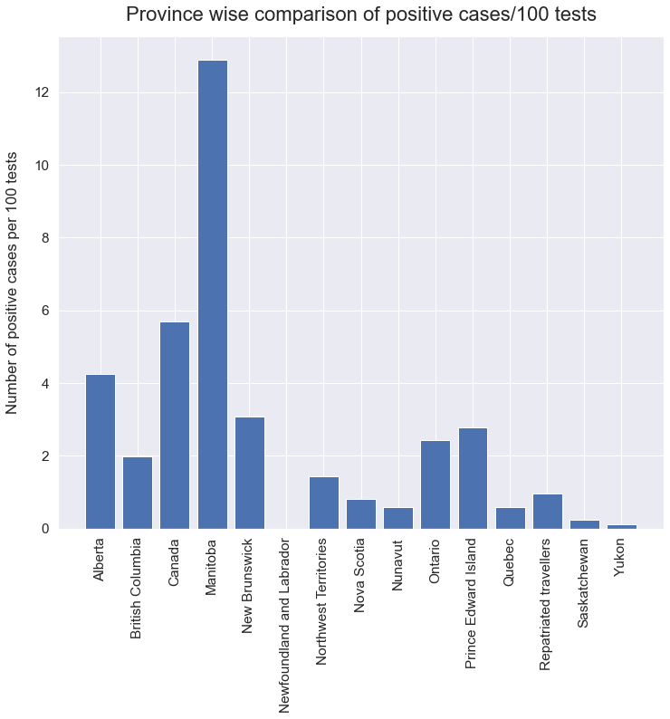

Slide 4
Inference
It is clear that province like Alberta, Ontario, British Columbia, Quebec and Manitoba are performing well in the testing.
Whereas, province like Northwest Territories, Nunavut, New Brunswick are underperforming in testing.
A new Performance Indicator has been added to measure the testing effectiveness in each province.
This is called testing effectiveness.

Slide 5
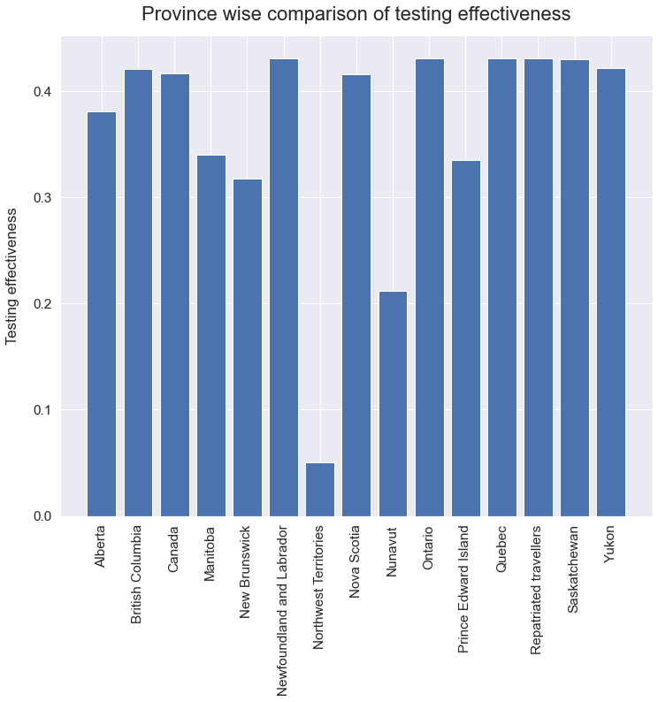
It is very clear that province like Northwest territories, Nunavut, New Brunswick are poor in testing.

Slide 6
Top 20 health regions
The top 20 health regions of the total 87 were found.
In these, if the data for the availability of resources (like beds, ventilators, etc) in each health region is also given, then a suggestion can be made on the exhaustion of resources as well the front line workers.
By making a transfer to the nearest health region with fewer patients by making use of the latitude and longitude, the treatment can be made more effective to a certain level and the spread can be contained easily.

Slide 7
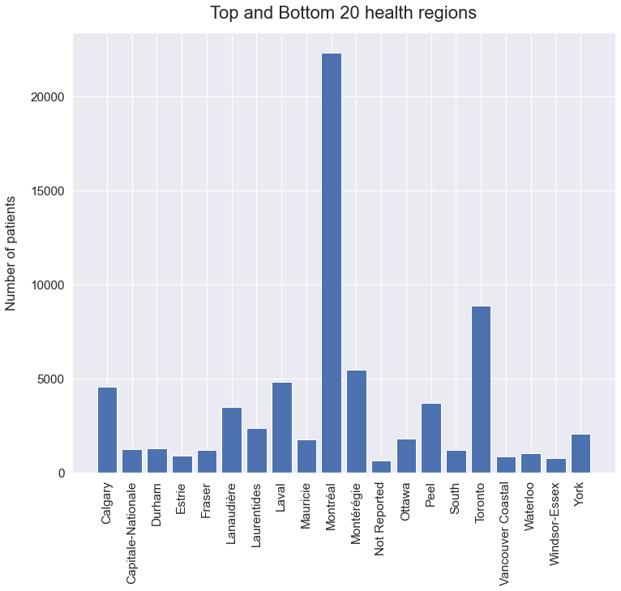
Among the top 20, Montréal is in the 1st position followed by Toronto. Therefore, existing patients or patients to be admitted in future can be shifted to the nearest health region with fewer patients like Estrie, Windsor-Eessex, Vancouver Coastal, South, etc.

Slide 8
Doubling rate
It is the rate at which the number of cases on a particular day gets doubled.
Here, the calculation was done on day basis.
The number of days required for the cases to get doubled was calculated and a graph was plotted between the date and the doubling rate on that date.
The graph was plotted for the entire country of Canada and for each provinces.

Slide 9
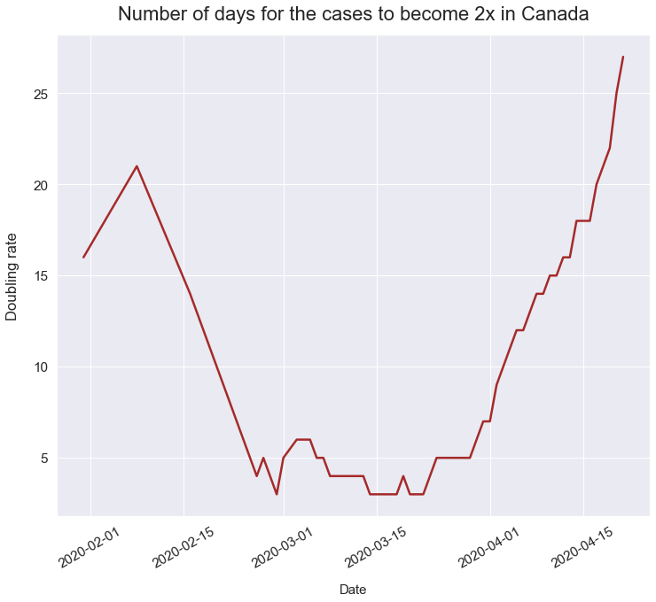

Slide 10
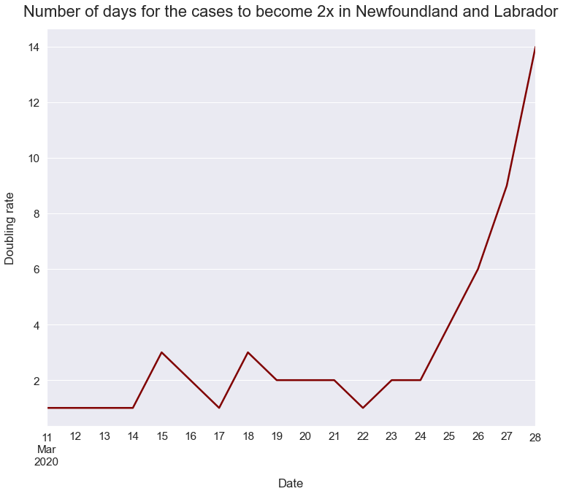

Slide 11
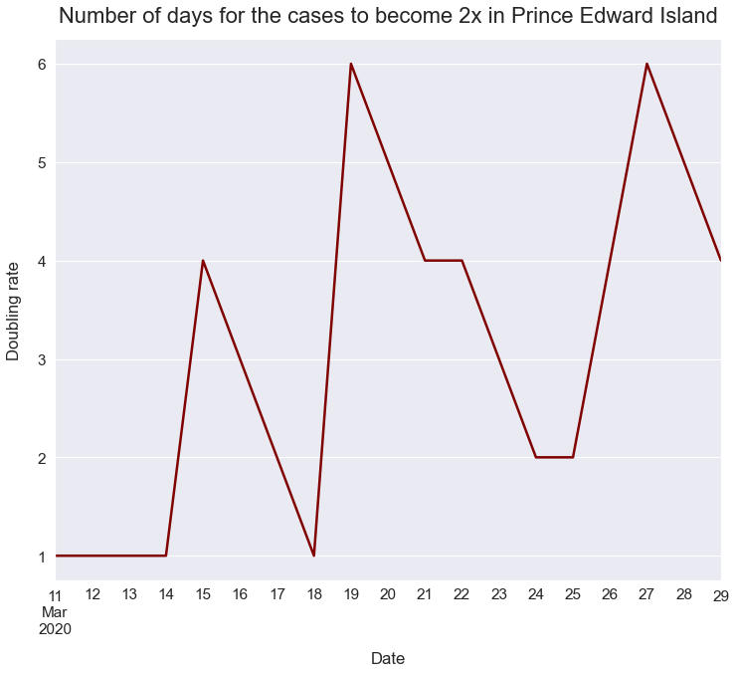

Slide 12
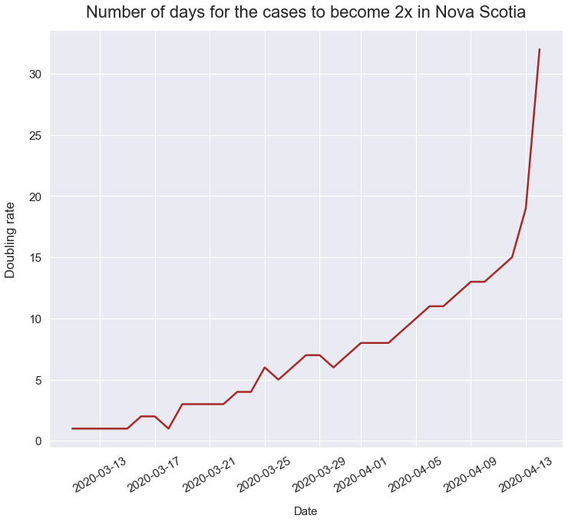

Slide 13
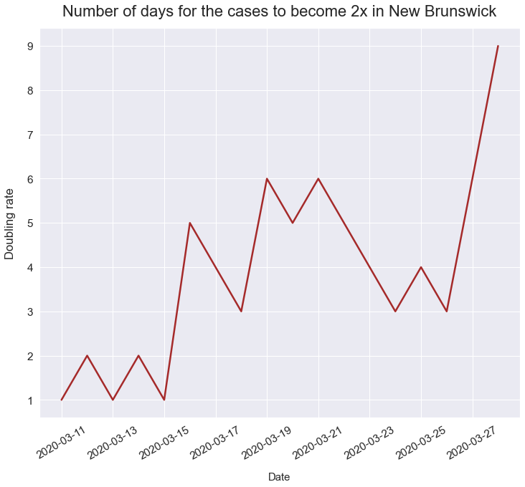

Slide 14
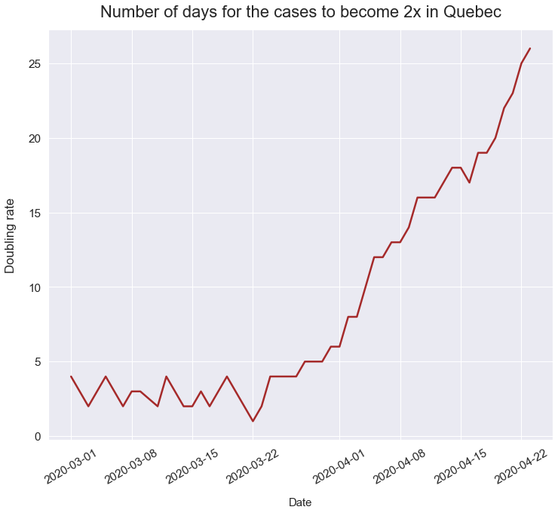

Slide 15
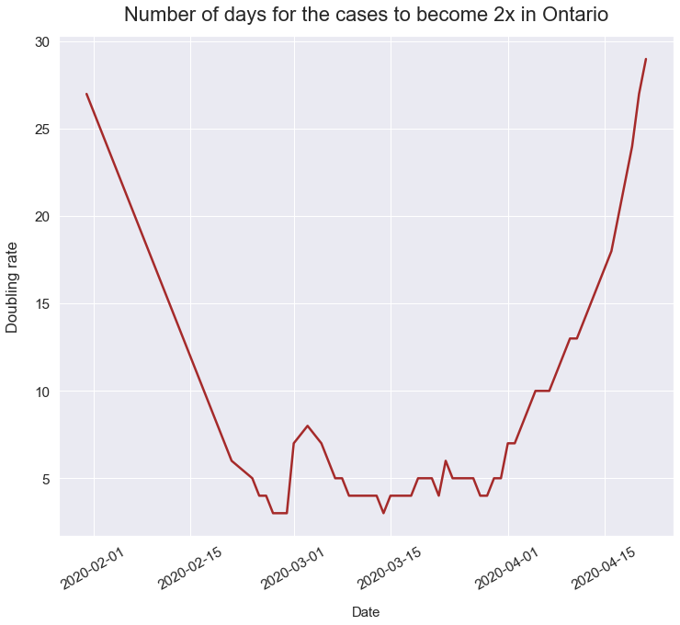

Slide 16
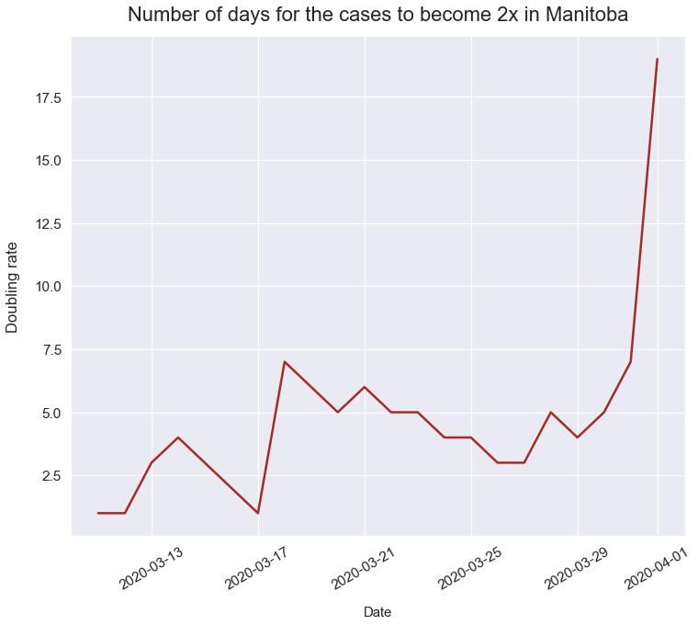

Slide 17
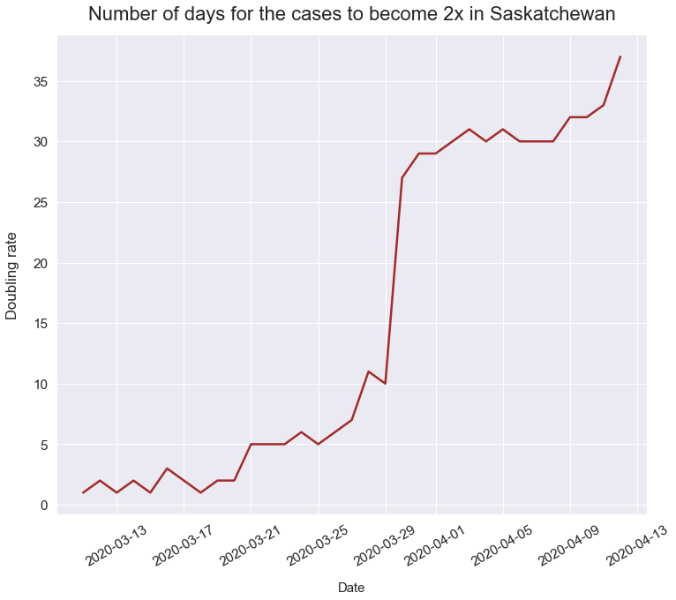

Slide 18
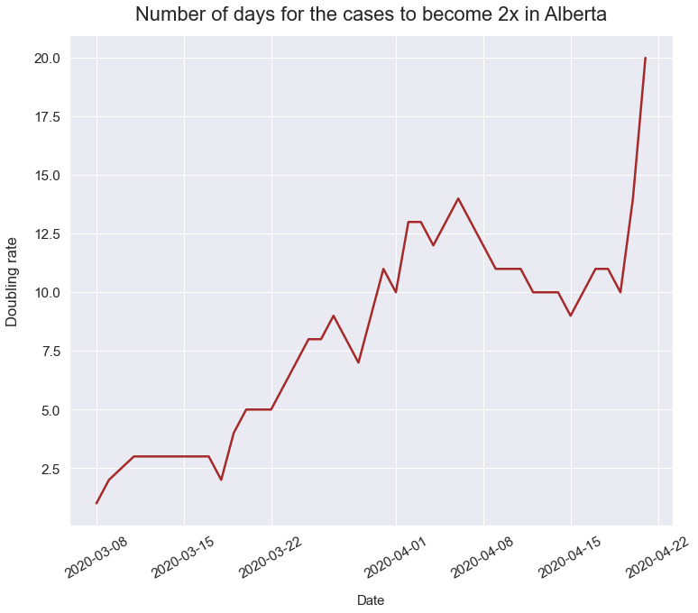

Slide 19
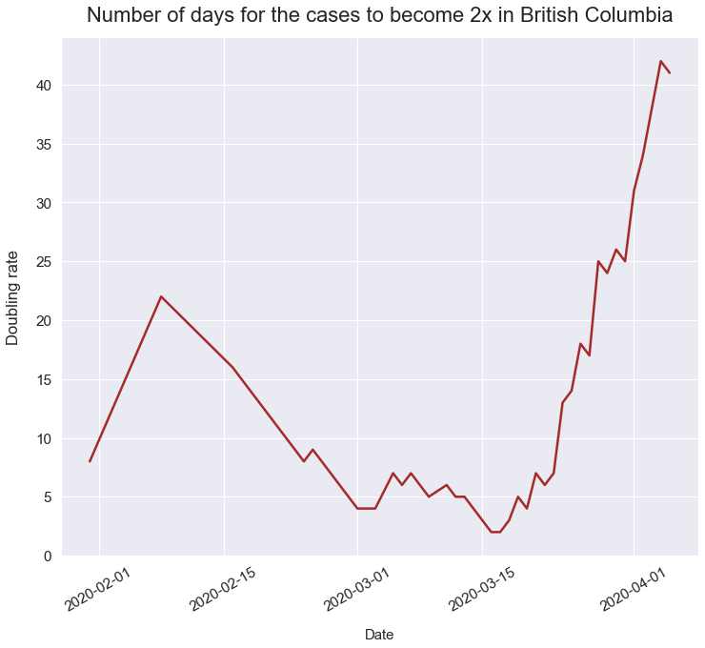

Slide 20
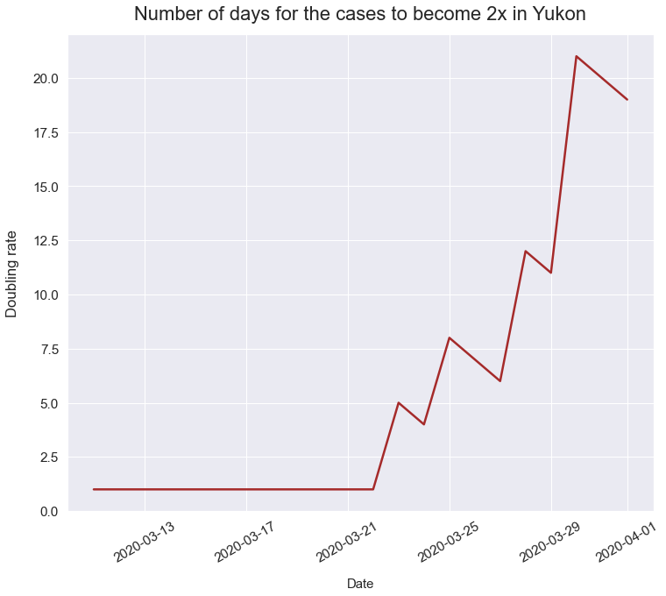

Slide 21
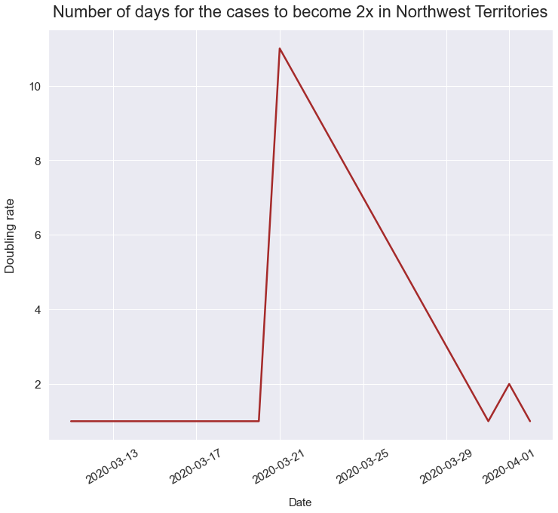

Slide 22
Inference
If the line has a negative slope, then it means the spread of the disease is high.
If the line is flat, then the spread is contained.
If the line has a positive slope, it means that the province is getting better.

Slide 23
THANK YOU

